Slide 1
Attendance Management System
By
Abdul Sami | 2K20/CSE/08 | Group Leader
Rameez | 2K20/CSE/90 | Member
Inayatullah Junaid | 2K20/CSE/52 | Member

Slide 2
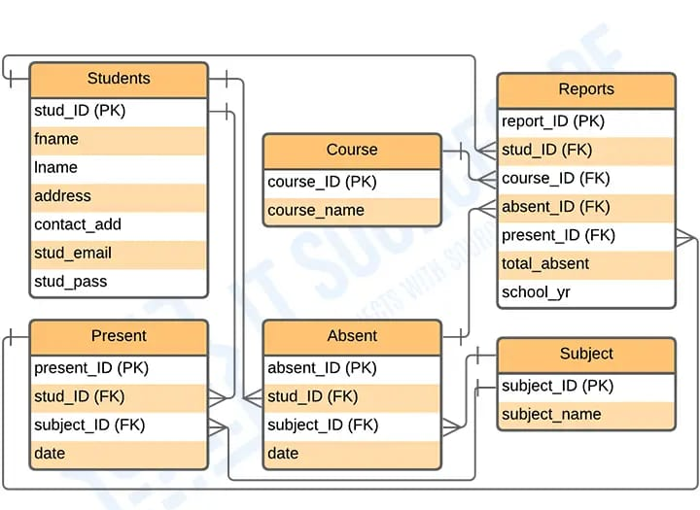
Entity Relationship Diagram Of Attendance Management System

Slide 3
Components of AMS
In this project we are going to build following components for AMS:
Window Forms:
Login form
Main form
User controls:
Dashboard
Add class
Add student
Attendance
Register
Report

Slide 4
Login form
In the login form, we added two textboxes for username and password.
we added a view and hide the icon for the password textbox.
We added a button for login and a label for forget password function.
In this component we first enter the username and password then press login it takes us to the main form but if the username or password is wrong it gives an alert under textboxes that the username or password is invalid.
If we click on forget the password then it opens a new form that asks the email of the user to whom we forgot the password if we provide the right email of the user, it will show the correct password and then we can log in.

Slide 5
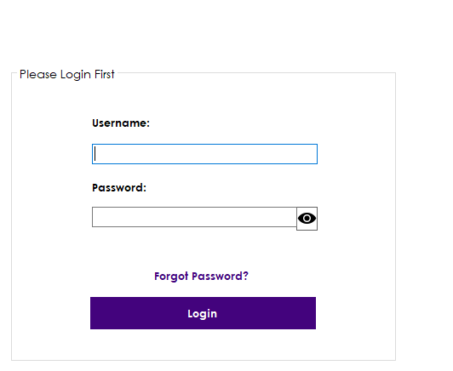
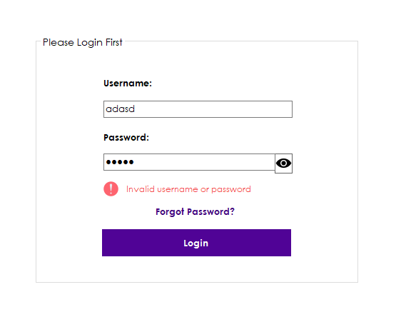
Fig 2.Invalid username and password alert
Fig 1.Login form

Slide 6
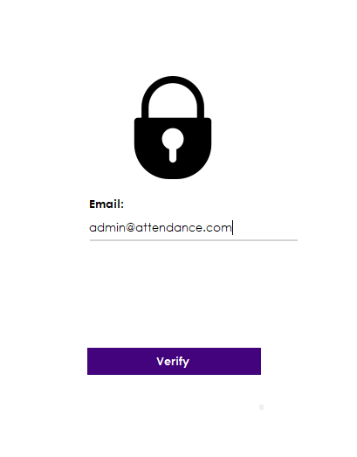
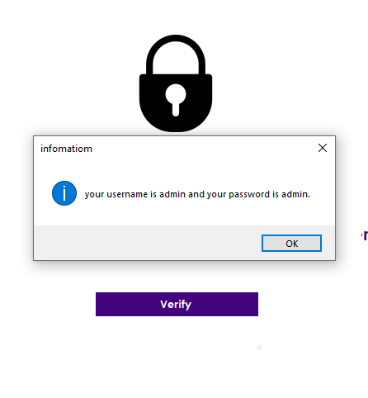
Fig 3.Forget password form
Fig 4.Showing password after verifying Email in Forget password form

Slide 7
Main Form
We build the main form using buttons for all the components of AMS and panels for designs.
It contains the buttons on the left side which help us navigate through different user controls we added like Add Class, Add Student, Attendance,…etc.
We added a label for “datetimepicker” which shows us the present time and date. We also added two other labels to show which user is logged in and the role of that logged-in user.
We also added a panel for the menu which opens when we click on the menu icon on the top-right-side of the main form which contains two buttons for minimizing the AMS window and logging out.

Slide 8
Dashboard
Now we build the dashboard using usercontrol function. In dashboard we added three different panels for total classes, total students and total user roles.as we enter data in respective components it will count the data and show us total count of data in those panels respectfully.

Slide 9
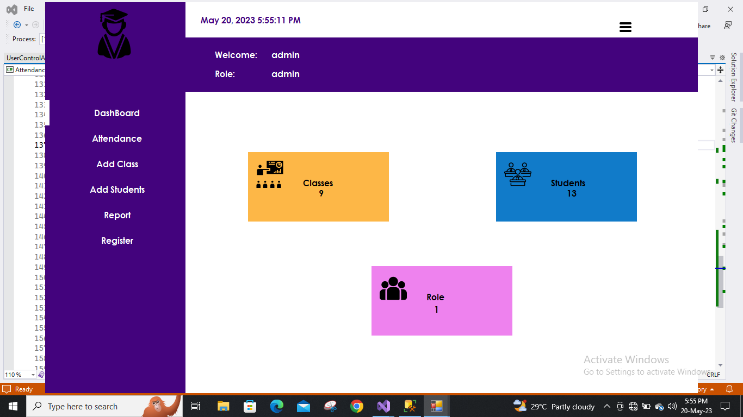
Fig 5.Main form Showing Dashboard

Slide 10
Fig 6.Dashboard UserControl

Slide 11
Add Class
We build the “Add Class” component using add usercontrol from which we add new forms in solution explorer.
In this component, we added tabcontrol function from the toolbox and added 3 tabs named Add Class, Search Class, and Update and Delete Class.
In the first tab, we added 4 textboxes for the name of the class, the total student in that class, the total number of males, and a total number of females.
We also added a button to save. in the second tab, we added a textbox for searching the name of the class and datagridview to view the data of the class that we searched.
In the third tab, we added the same as the first tab but we added two buttons named update and delete for updating the class or deleting the class. If we update the class a window popup shows if data has been updated or not. If we want to delete any class its shows a popup window to ask for confirmation.

Slide 12
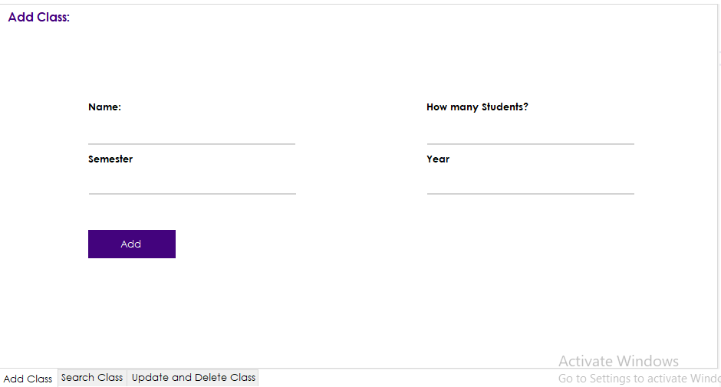
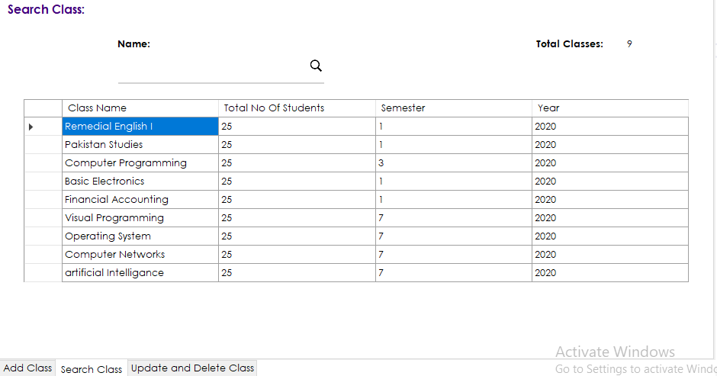
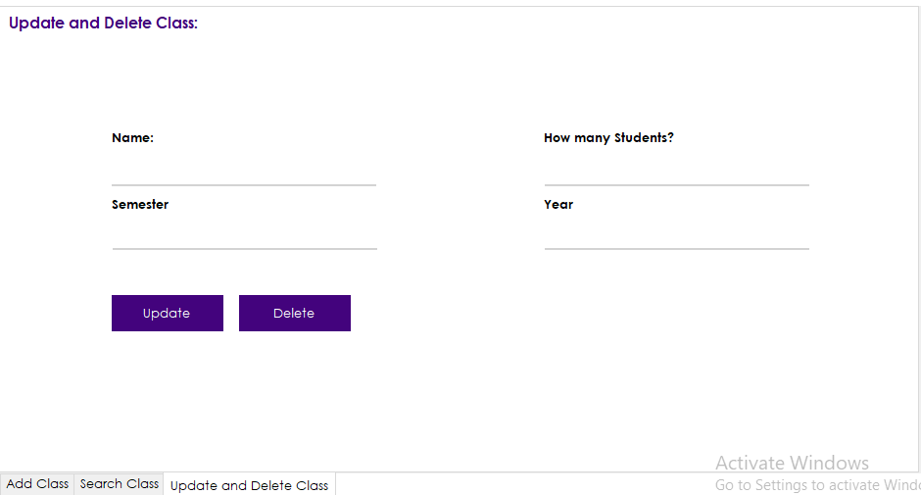
Fig 7.Add Class Tab
Fig 8.Search Class Tab
Fig 9.Update and Delete Class Tab

Slide 13
Add Student
We build the “Add Student” component the same as the “Add Class” component by using usercontrol and adding tabcontrol with three tabs from the toolbox named Add Student, Search Student, and Update and Delete Student.
In the first tab, we added 2 textboxes for name, and register number and we added a combo box for class to choose from which has been added and we added 2 radio buttons to choose gender(male and female).
We also added a button to save the provided data. In the second tab, we added a textbox for the search function, a combobox for search by option, and a datagridview for viewing data that we searched.
In the third tab, we added the same contents as the first tab but we added two buttons for the update and delete functions but as we try to delete or update it shows a popup window for confirmation.

Slide 14
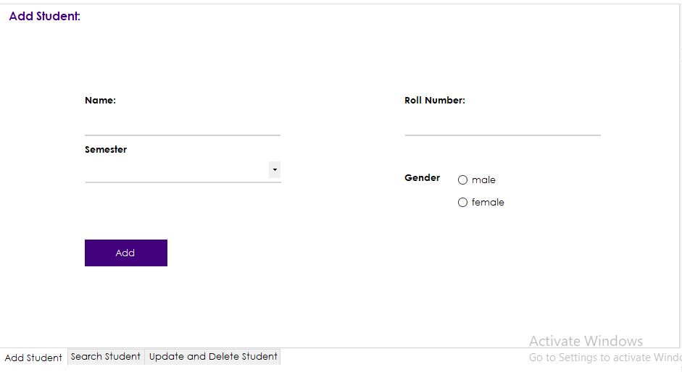
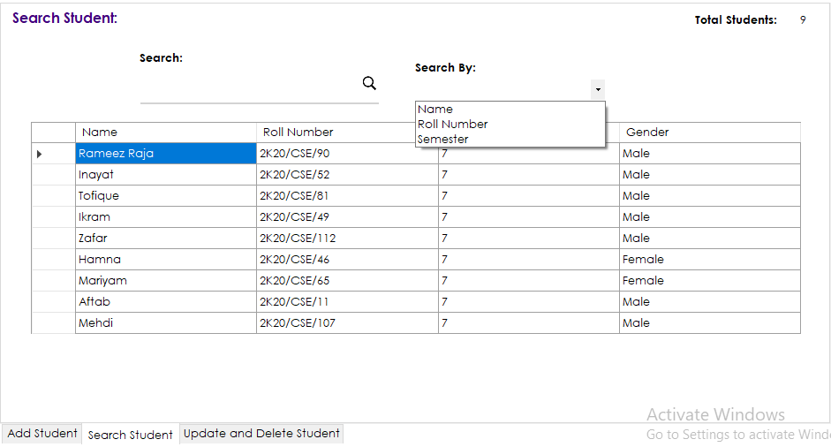
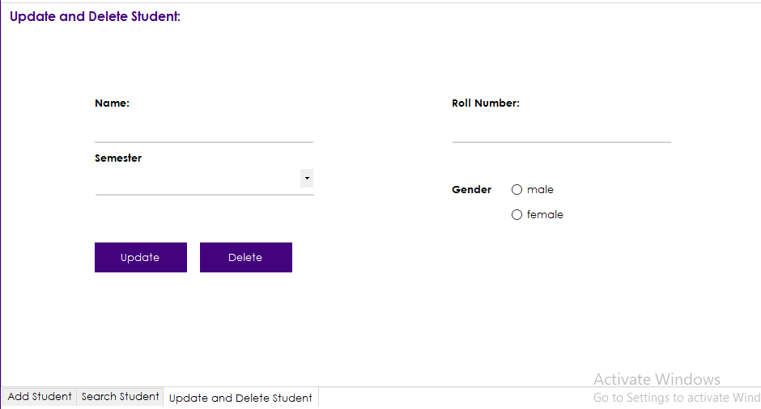
Fig 10.Add Student Tab
Fig 11.Search Student Tab
Fig 12.update and delete Student Tab

Slide 15
Attendance
We build “Attendance” using the usercontrol function by adding tabcontrol from the toolbox. We added a tab to tabcontrol and named it “Marked Attendance".
We added datetimepicker for a date for attendance and combobox for classes and datagridview which shows the data of students and we use its status column to record the attendance of students.
We use the checkbox in the status column for recording attendance when it is checked it means the student is present otherwise he is absent. We also added a button named “done” for saving attendance records.

Slide 16
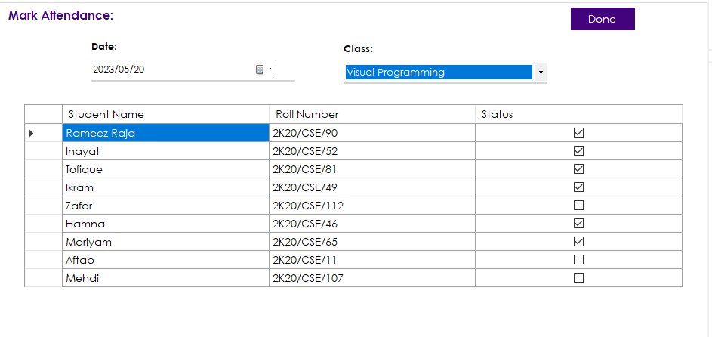
Fig 13. Mark Attendance UserControl

Slide 17
Add User/Register
We build the “Add User/Register” component using the usercontrol function by adding tabcontrol with 3 tabs named Add user, Search user, and updating and deleting user.
In the first tab, we added 6 textboxes for name, password, phone number, DOB, email, address, and CNIC.
we also added 2 radio buttons for gender(male and female) and a checkbox for the role(admin) and a button for saving data.
In the second tab, we added a textbox for the search function and a combobox for the search by option function. in the third tab, we added the same contents as the first tab but we added two buttons for the update and delete function as we try to delete or update it shows a popup window for confirmation.

Slide 18
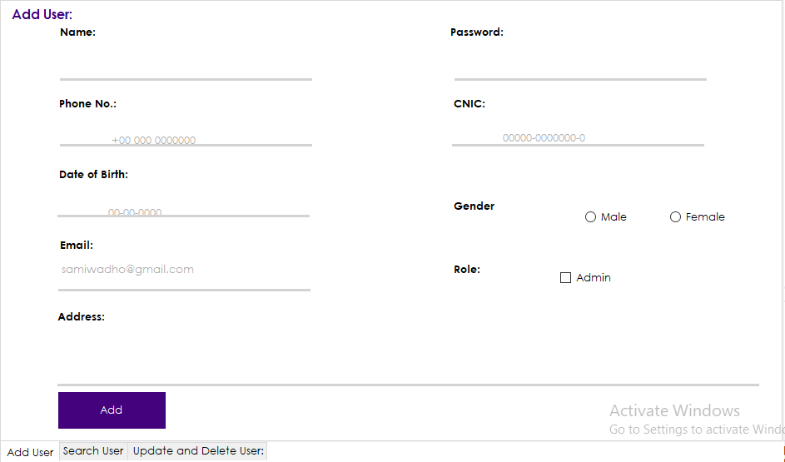
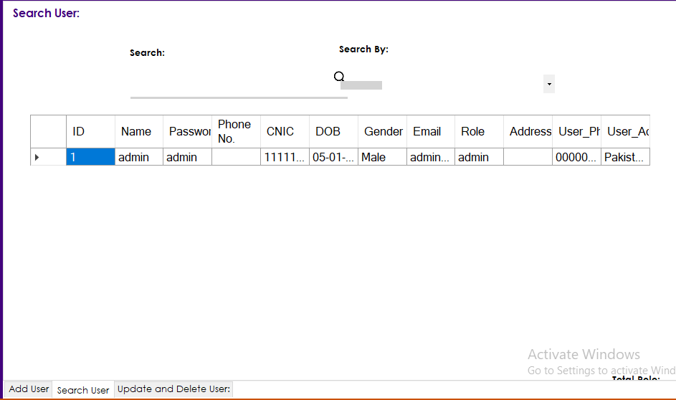
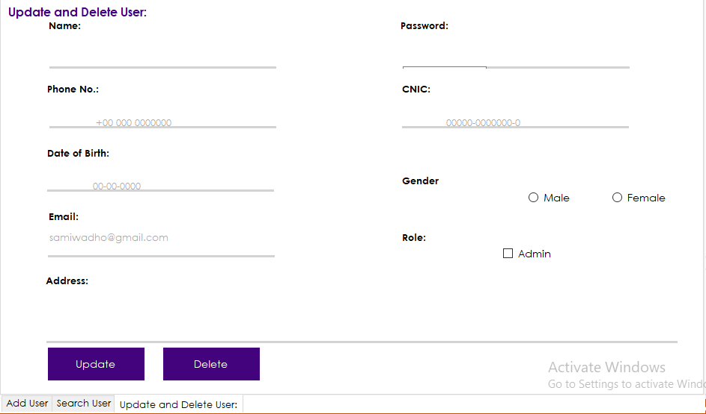
Fig 14.Add User Tab
Fig 15.Search User Tab
Fig 16.Update and Delete User Tab

Slide 19
Report
We build the “Report” component using the usercontrol function. we used tabcontrol from the toolbox and added 2 tabs named class report and monthly report. in the first tab, we added a datetimepicker for the date of attendance and combobox for the selection of class. we also added a datagridview for viewing the attendance of students and we added a print icon for printing crystal reports of class attendance.in the second tab, we added the same contents as the first tab but it shows us the whole record of attendance in a particular month selected in combobox. we also added a print icon for printing crystal reports of monthly attendance

